Slide 1
2/11 Meeting

Slide 2
Roadmap of the Meeting
Updates
Case Study
Important forms/Links
1
3
5
2
4
Current Events
Portfolio Details

Slide 3
1. Updates

Slide 4
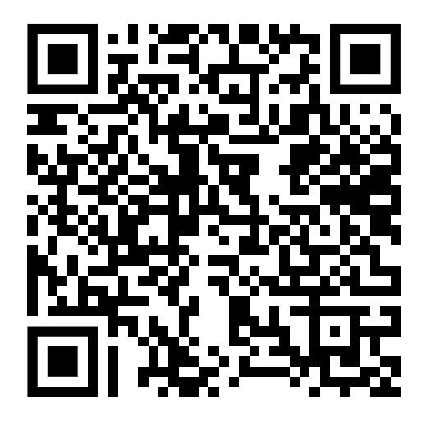
Updates
Take a minute to sign up for a pitch

Slide 5
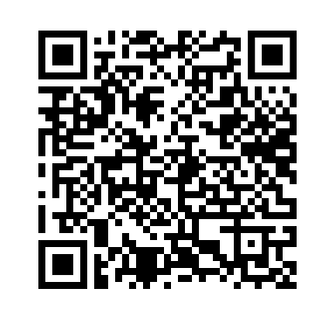
Updates
Take a moment to sign up for a current event presentation

Slide 6
2. Current Events

Slide 7
On December 12th, FT Partners announced Brigit’s $460 million sale to Upbound
Advised by:
FT Partners
Advised by:
Greenhill & Co.

Slide 8
Company Overview
Transaction Details
Brigit is a holistic financial health app that helps users budget, receive wages early, build credit through savings, and save effectively
Upbound Group is a technology and data-driven leader in accessible and inclusive financial products that address the evolving needs and aspirations of underserved customers
The transaction was financed with 75% in cash and 25% in stock and included a $60 million earnout
The purpose of the acquisition was to expand Upbound’s strategic focus on expanding technology driven financial solutions and to improve risk management and fraud prevention

Slide 9
3. Case Study

Slide 10
Overview of Stripe
Online Payment Processing: Stripe provides APIs and tools for businesses to accept payments online, including credit cards, digital wallets, and ACH transfers.
Financial Services & Automation: Offers solutions like Stripe Billing for subscriptions, Stripe Treasury for banking services, and Stripe Issuing for creating virtual/physical cards.
Developer-Friendly & Global Reach: Known for its easy-to-integrate APIs, fraud prevention (Stripe Radar), and support for 135+ currencies across multiple countries.
Notes:
Will take five and vote from them

Slide 11
Competitive Advantages
Developer-Centric Approach: Best-in-class APIs and SDKs that allow businesses to integrate payments with minimal friction.
Global Payment Coverage: Supports 135+ currencies and dozens of payment methods, including cards, digital wallets, and local bank transfers.
Network Effects & Data Insights: Leverages transaction data to optimize fraud detection and conversion rates.
Scalability & Reliability: Boasts 99.999% uptime and handles peak traffic (e.g., Black Friday, large SaaS transactions) without failure.
Ecosystem Play: Offers a full-stack financial platform, not just payment processing, making it indispensable for businesses.
Notes:
Locking tokens to support network security: Users commit (stake) their cryptocurrency to help validate transactions and maintain the blockchain.
Earn rewards: In return for staking, participants receive rewards (similar to earning interest).
Risk of slashing: If validators act dishonestly or fail to participate, they may lose part of their stake.
Technically, PoH itself is not a mining mechanism like Proof of Work (PoW). Instead, PoH is used as a time-ordering mechanism within Solana’s Proof of Stake (PoS) system. Here’s how it works:

Slide 12
Example Customer
About Eight Sleep: Eight Sleep is a sleep technology company that develops smart mattress covers (Pods) to regulate body temperature, track sleep metrics, and improve overall sleep quality.
How Stripe Made an Impact:
70% Increase in Conversions – Optimized, single-page checkout improved the purchasing experience.
50% Reduction in Subscription Failures – Smart payment recovery minimized involuntary churn.
45% Fewer Chargebacks – Advanced fraud detection reduced false declines.
Seamless Global Expansion – Enabled a single storefront for multiple countries.
Fast & Efficient Integration – Launched in just two months with Stripe’s support
Notes:
Smart contracts: smart contract is a computer program or a transaction protocol that is intended to automatically execute, control or document events and actions according to the terms of a contract or an agreement
TPS: Transactions Per Second
Scalability

Slide 13
Recent Headlines and Future Catalysts
IPO Speculation: Despite remaining private, reports suggest an IPO could be on the horizon within the next 1-2 years
They were valued at $95 billion (2021) and are now worth $70 billion
AI & Fraud Prevention: Expanding machine learning-based fraud detection with Stripe Radar to reduce payment failures and chargebacks.
New Banking-as-a-Service Offerings: Strengthening Stripe Treasury to enable embedded finance for platform businesses.
Expansion in Emerging Markets: Increasing presence in Latin America, Southeast Asia, and Africa, tapping into underbanked economies.

Slide 14
Interactive Activity
Imagine you are a consultant hired by Stripe to analyze the company and create a growth strategy for the company to implement. This could be a new product they should develop, a customer they should focus on, etc. Come up with the strategy or idea you would like to implement and give us a couple reasons why:
Teams will be voted on! The team that wins gets a personalized high five from Russell!!!!!!! :0

Slide 15
Important Forms

Slide 16
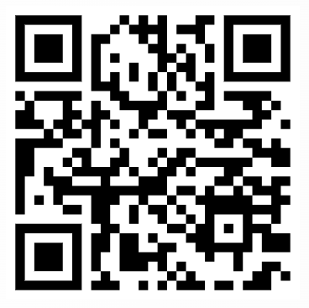
Join Our Slack For Communications

Slide 17
5.
Questions?
Email us: fintech@brown.edu

Slide 18
Thank You
We hope to see you back here next Tuesday @ 7 pm → Friedman 208

