Slide 1
11/12/2024

Slide 2
Meeting Agenda
Industry Updates
Education Module
Pitch from Payments
Discussion
Vote
Notes:
Grace

Slide 3
Industry Updates

Slide 4
Justice Department Sues Visa :)
Visa accused of maintaining an unlawful monopoly in the debit card payments market
Engaging in exclusive agreements that restrict competition and hinder new entrants
Raises prices for everyone
DOJ’s action aims to dismantle monopolistic practices, fostering a more competitive and fair debit card payment landscape

Slide 5
Trump’s Pro-Crypto Policies
Reforming the SEC(Security and Exchange Commission)
Fire Gary Gensler(current head)
Create a new strategic bitcoin reserve
Requiring the FED to hold Bitcoin as a reserve asset(like gold)
Buying 1 million Bitcoin over 5 years, holding for 20 years
Prevent the creation of a central bank digital currency
Trump’s personal gains: World Liberty Financial(insider - sell non-transferable tokens)
What should be regulated by the SEC?
Notes:
SEC - regulating financial assets in the US
Democrats challenge crypto progress
Digital dollar: helps with tackling tax evasion, money laundering, terrorist financing, provide better knowledge for states of their economy(better economic policies)

Slide 6
IRS Announces 2025 Tax Brackets
Standard Deduction Increase:
Single Filers increases to $15,000 (up $400)
Joint Filers increases to $30,000 (up $800)
Marginal Tax Bracket:
Income thresholds for all brackets adjusted slightly upwards
Earned Income Tax Credit (EITC)
Max EITC for families with 3+ children increases to $8046 (up $216)
Changes reflect inflation adjustments
Reduces Tax Burdens
Increase Deductions & Income Thresholds
Prevents taxpayers from entering higher tax brackets
Notes:
Sources: https://www.irs.gov/newsroom/irs-releases-tax-inflation-adjustments-for-tax-year-2025
https://irs.gov/newsroom/irs-provides-tax-inflation-adjustments-for-tax-year-2024

Slide 7
Robinhood starts Election Betting Market
Robinhood has launched a betting market for the presidential election only for US citizens
Users can wager on presidential candidates, Kamala Harris and Donald Trump, via event contracts (priced between $0.02 and $0.99 | $1 payout | 5000 contracts max per user)
aims to engage users in political events
It reflects the increasing interest in political betting
However, launch raises questions about the implications of gambling on political outcomes:
Commodity Futures Trading Commision (CFTC) has expressed concerns regarding its influence on the integrity of election
Notes:
Sources:
https://www.forbes.com/sites/dereksaul/2024/10/28/robinhood-launches-presidential-election-betting-market-allowing-users-to-wager-on-harris-and-trump/
https://www.cnbc.com/2024/10/28/robinhood-jumps-into-election-trading-giving-users-chance-to-buy-harris-or-trump-contracts.html

Slide 8
Education Module: Payments

Slide 9
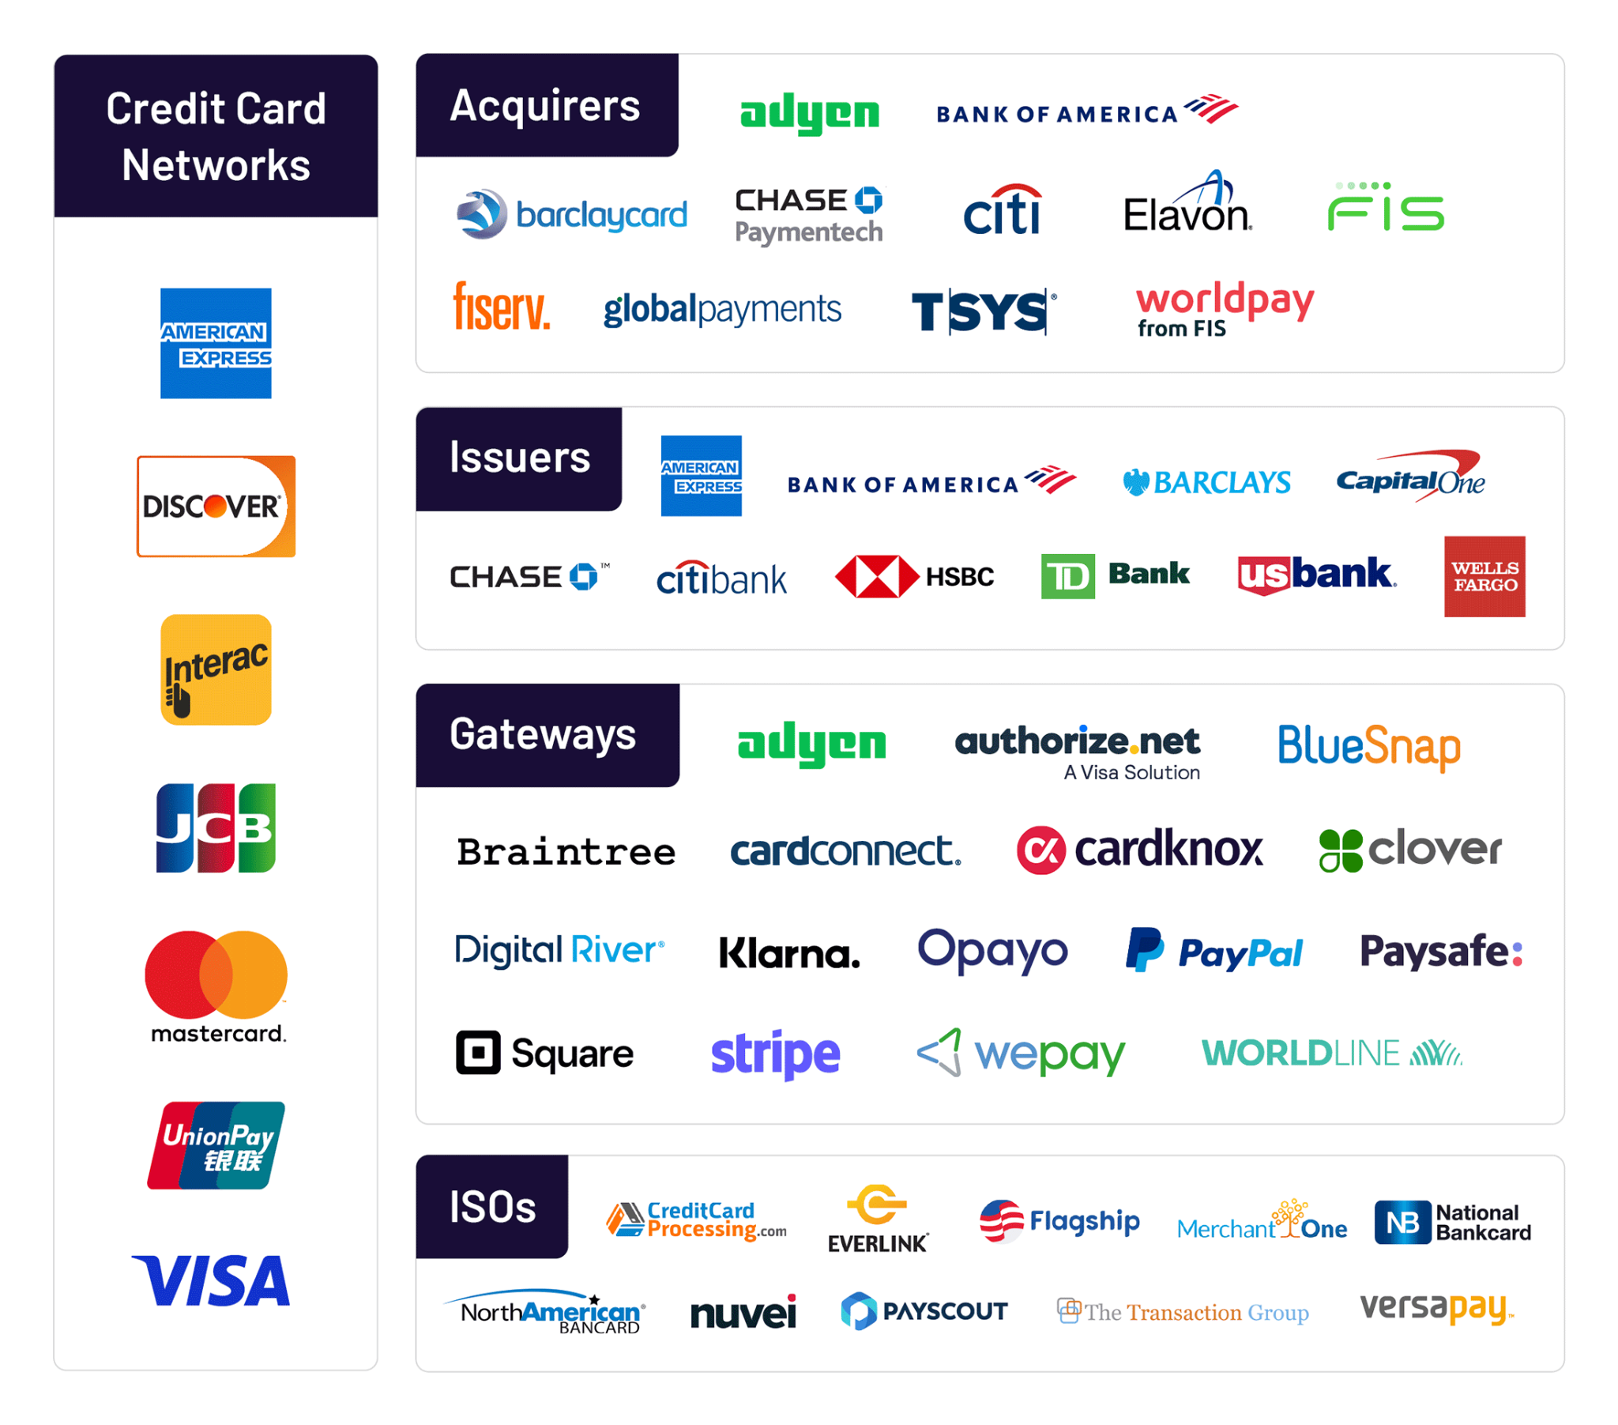
What is the Payments Industry?
Industry focused on enabling monetary transactions between individuals, businesses, and institutions
Key Components:
Payment processors
Banks and financial institutions
Technology providers
Notes:
SEC - regulating financial assets in the US
Democrats challenge crypto progress
Digital dollar: helps with tackling tax evasion, money laundering, terrorist financing, provide better knowledge for states of their economy(better economic policies)

Slide 10
Key Trends in Payments
Digital Transformation
Shift from cash to digital payments (ex. Mobile wallets)
Contactless Payments
Rise in NFC and QR code Payments
Buy Now, Pay Later
Increasing popularity among consumers
Blockchain &
Notes:
SEC - regulating financial assets in the US
Democrats challenge crypto progress
Digital dollar: helps with tackling tax evasion, money laundering, terrorist financing, provide better knowledge for states of their economy(better economic policies)

Slide 11
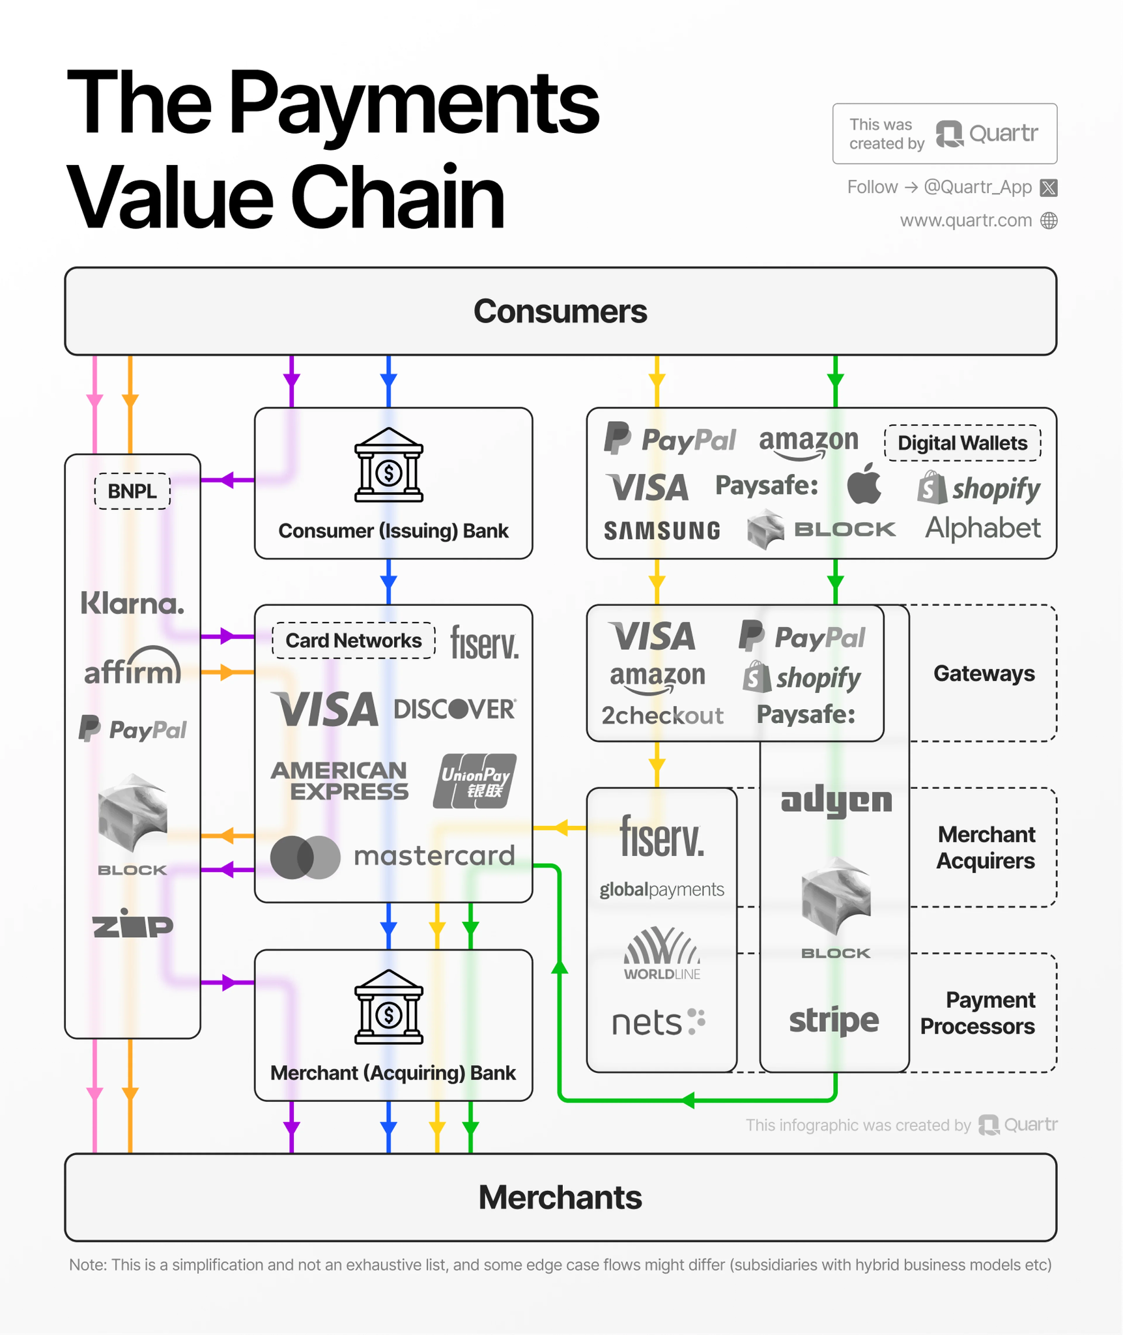
How Payment Systems Work
Initiation
Customer initiates payment (card, phone, etc.)
Authorization
Payment processor requests approval from bank
Clearing
Transaction details sent between bank networks
Settlement
Funds transferred to merchant’s account
Notes:
SEC - regulating financial assets in the US
Democrats challenge crypto progress
Digital dollar: helps with tackling tax evasion, money laundering, terrorist financing, provide better knowledge for states of their economy(better economic policies)

Slide 12
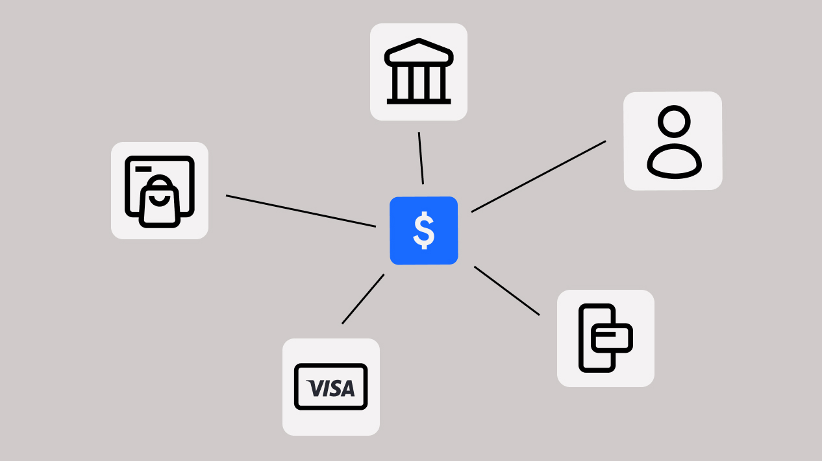
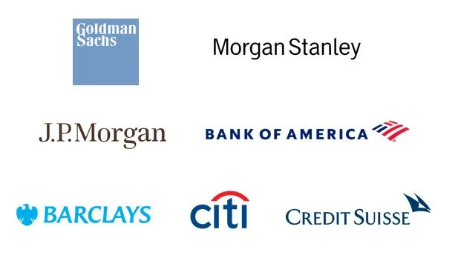
Major Players
Networks
Visa, Mastercard, American Express
Processors
Stripe, Square, Adyen
FinTechs
PayPal, Venmo, Apple Pay, Cash App
Banks
JP Morgan Chase, Wells Fargo
Notes:
SEC - regulating financial assets in the US
Democrats challenge crypto progress
Digital dollar: helps with tackling tax evasion, money laundering, terrorist financing, provide better knowledge for states of their economy(better economic policies)

Slide 13
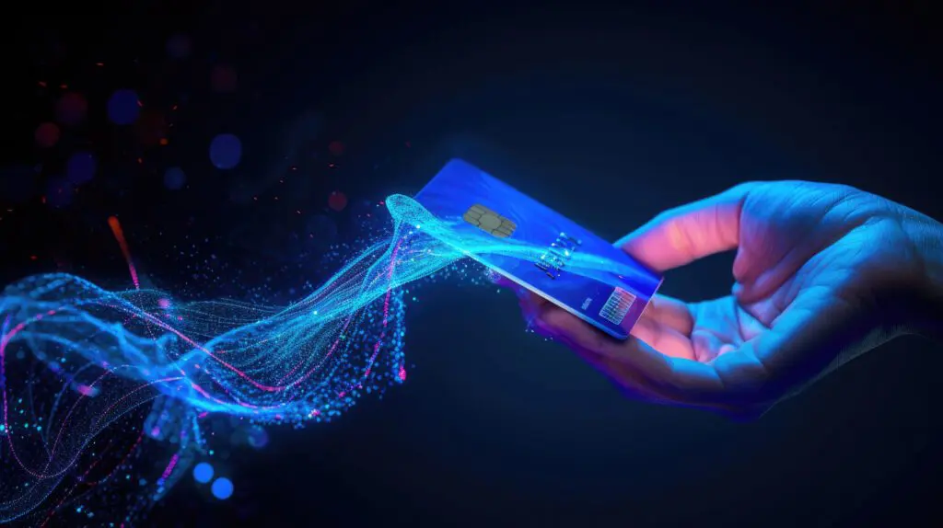
Opportunities & Challenges
Opportunities
Expanding in emerging markets
Integration with AI and machine learning for fraud detection
Cross-border and multi-currency payment solutions
Challenges
Regulatory hurdles
Cybersecurity and fraud risks
High competition and evolving customer expectations
Notes:
SEC - regulating financial assets in the US
Democrats challenge crypto progress
Digital dollar: helps with tackling tax evasion, money laundering, terrorist financing, provide better knowledge for states of their economy(better economic policies)

Slide 14
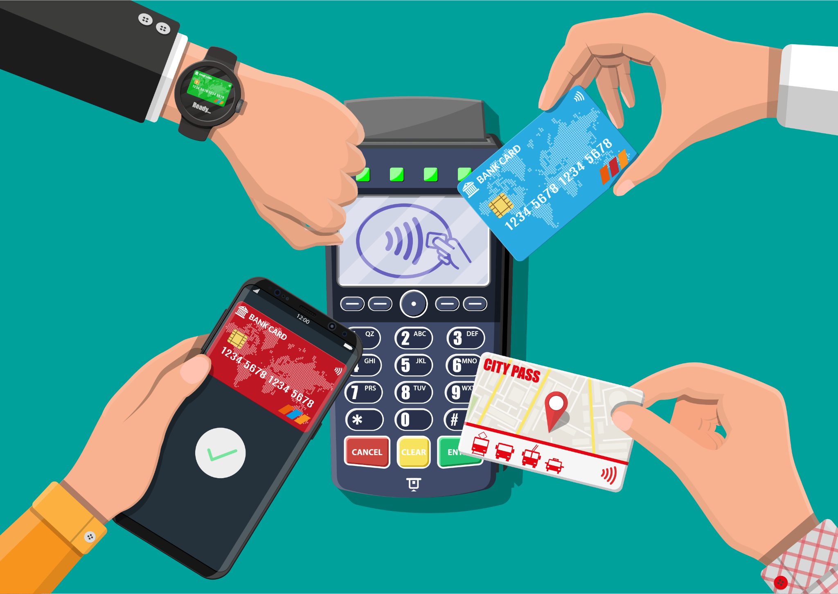
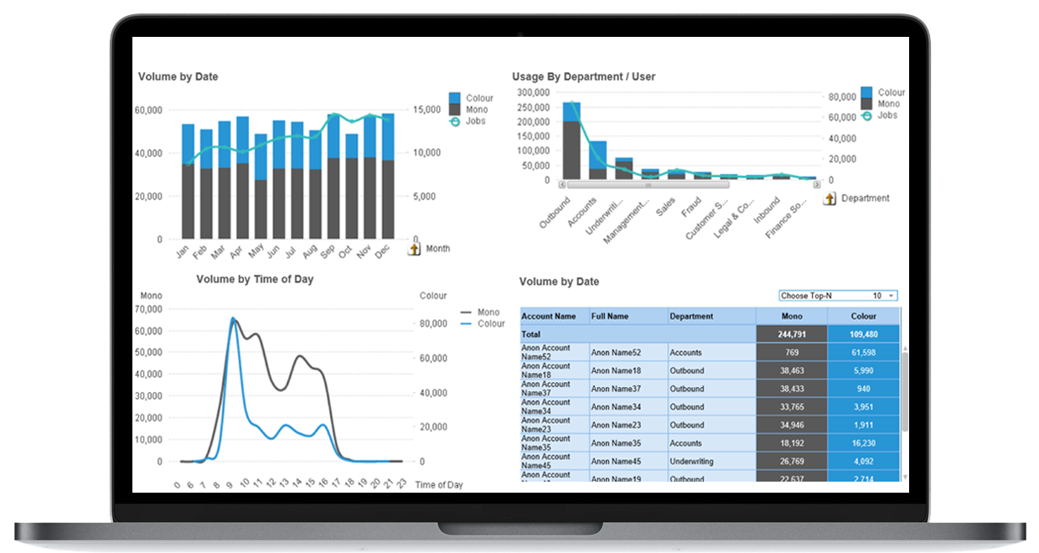
Future of Payments
Emerging Technologies
AI, Blockchain, Internet of Things for seamless transactions
Personalized Experiences
Using data analytics to tailor customer experiences
Sustainable Payments
Focus on eco-friendly payment methods
Notes:
SEC - regulating financial assets in the US
Democrats challenge crypto progress
Digital dollar: helps with tackling tax evasion, money laundering, terrorist financing, provide better knowledge for states of their economy(better economic policies)

Slide 15
Pitch

Slide 16
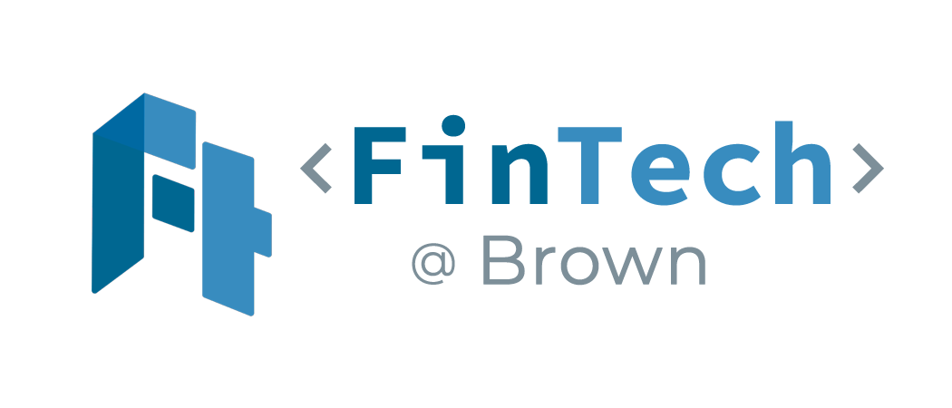
Corpay Inc. (NYSE: CPAY)
Fintech@Brown
November 10th, 2024

Slide 17
Company Background - Max
The Business
Global business payments and spend management company focused on control-expense related purchases and payments
Generally operates in B2B sector, helps businesses handle domestic and international payment processes
Revenue streams primarily from transaction fees, currency exchange margins, and subscriptions
Origin/History
Founded 2000 in Atlanta, GA as FLEETCOR—specialized payment products and services company primarily focused on fleet cards for business-managing vehicle-related expenses (only recently changed name March 2024)
Notable acquisitions—2014 Pacific Pride, Comdata, $3.45B, 2017 Cambridge Global Payments ($690M) Cross-global payments
2020 created by combining Cambridge, AFEX, Comdata Corporate Payments, and NvoicePay
Management Team
CEO Ron Clarke joined in 2000, diversified in marketing for two decades before joining the firm
CFO Tom Panther joined March 2023, spent two decades prior at SunTrust Banks
Strong executive leadership in Europe, North and South America (Alan King, Armando Netto)
Competitive Advantages & Disadvantages
Comprehensive service offerings
Cross-border payments, corporate card programs, payment automation
Global Reach
Strong operations in Europe, North America, South America, Asia—140
currencies, 200 countries, $145B+ annually
Integration challenges and regulatory risks
High acquisition count, large global reach results in risk from changes in
financial regulations
Notes:
phases for fda approval – phase 1: safety and dosage (<50); phase 2: effectiveness and side effects (100); experimental comparison to other treatments/efficacy in long run (100-1000s); submit for fda review and approval
compared to only 23 in phase 3 and 4 in registration last year around this time
largest M&A transaction in the biopharma industry
pfizer largest rival is JNJ in terms of market cap and total revenue (397 billion)but JNJ also develops
By 2030, the global biopharmaceutical market is projected to reach $856.1 billion and predicted to expand at a compound annual growth rate (CAGR) of 12.5%.
Pfizer also stands to lose approximately $17 billion in sales over the next several years due to the loss of exclusivity (LOE) on several large drug franchises: Ibrance (breast cancer) and Eliquis https://www.jenseninvestment.com/insights/pfizer-vaccine-growth/
https://www.fiercepharma.com/pharma/done-deal-pfizer-completes-43b-acquisition-seagen-doubling-its-oncology-pipeline

Slide 18
Products & Relevant Technologies - Matias
Corporate Payments
Offering AP Automation
Commercial Cards
Cross Border Payments
Vehicle Payments
Fuel and EV charging
Tolls
Parking
Auto Insurance
Maintenance and Service
Lodging Payments
Managed Lodging Programs
Airline passengers and Crews
Ap Automation
Accounts payable automation uses AI-driven technologies to help streamline and enhance accounts payable processes.
Commercial Cards
Basically a corporate credit card
They have higher limits
Cross Border Payments
Streamlined Payments across Countries

Slide 19
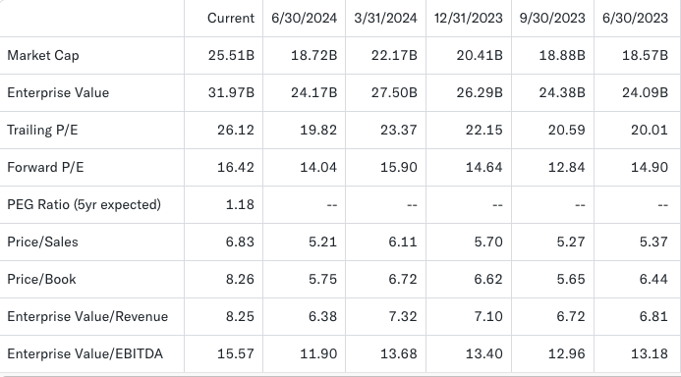
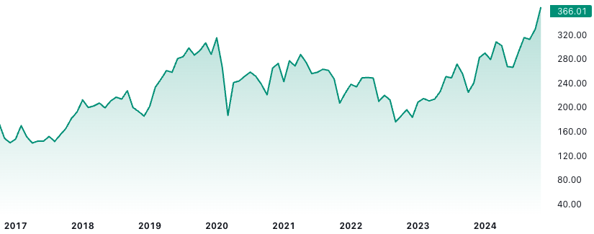
Financials, Valuation, and Outlook - Alvin
Current Financials
Current Price
$366.01
Market Cap
25.51B
Trailing P/E
26.12
EV/EBITDA
15.58
EV/Revenue
8.25
Earnings Per Share
14.32
Future Expectations
Forward P/E
16.42
Return on Equity
32.84%
Yahoo Finance
TradingView
Source: Yahoo Finance, TradingView

Slide 20
Peer Comparison - Max
Flywire
Global payments and enablement software company specializing in facilitating transactions in education, healthcare, travel, and business-to-business (B2B) sectors. Founded in 2009, based in Boston, MA
Block
Financial services and mobile payments company which provides services to consumers, small, and medium-sized businesses (SMBs)
U.S. market leader in Point-of-Sale systems through Square
Paypal
leading global digital payments platform that facilitates online money transfers and serves as an electronic alternative to traditional paper methods like checks and money orders. Focus on digital wallet and peer-to-peer payments
Company | Market Cap (B) | Trailing PE | EV/Revenue | EV/ EBITDA
Corpay (NYSE: CPAY) | 25.51 | 26.12 | 8.25 | 15.58
Flywire (NAS: FLYW) | 2.61 | 123.47 | 4.07 | 128.99
Block (NYS: SQ) | 46.21 | 44.65 | 1.71 | 26.29
Paypal (NAS: PYPL) | 83.22 | 19.86 | 2.58 | 12.54
Source: ATTOM Data Solutions, The White House
Notes:
Investment Thesis: Leveraging Pfizer's Strategic Acquisitions and Oncology Focus for Long-Term Growth
Introduction:
Pfizer, a pharmaceutical giant, has strategically positioned itself to navigate the challenges posed by patent expirations of its blockbuster drugs by engaging in strategic acquisitions and focusing on oncology treatments. This investment thesis proposes a BUY recommendation for Pfizer stock, capitalizing on the company's commitment to leveraging mergers and acquisitions (M&A) to mitigate revenue loss and its focus on the oncology market.
1. Strategic Acquisitions and Oncology Focus:
Pfizer has a history of strategic acquisitions aimed at bolstering its oncology portfolio, exemplified by the recent acquisition of Seagen in December 2023. With several patents for oncology drugs set to expire by the end of the decade, representing 40% of the company's 2021 revenue, Pfizer's focus on expanding its oncology pipeline through M&A activity is expected to continue. Moreover, the announcement last Thursday of their establishment of a dedicated cancer research business unit underscores Pfizer's long-term commitment to the oncology market.
2. Revenue Diversification and Growth Prospects:
Despite recent declines in revenue attributed to factors such as the expiration of patents and fluctuations in demand for COVID-19 treatments, Pfizer's strategic investments in oncology are poised to drive revenue diversification and long-term growth. The company's focus on developing eight blockbuster cancer drugs by 2030 signals its intent to capitalize on emerging opportunities in the oncology space.
3. Timing Opportunity:
Pfizer's stock currently sits at a low valuation, presenting an opportune moment for investors to capitalize on the company's growth potential. With Pfizer transitioning from an investment phase to an execution phase in 2024, investors can anticipate the realization of growth initiatives, particularly in the oncology segment.
4. Risk Considerations:
While Pfizer faces challenges such as declining demand for certain products and ongoing integration following acquisitions, these factors are mitigated by the company's robust balance sheet, strategic focus, and long-term growth prospects in oncology.
Conclusion:
In light of Pfizer's strategic acquisitions, focus on oncology, and favorable valuation, this investment thesis recommends a BUY position on Pfizer stock. Despite short-term challenges, Pfizer's long-term growth trajectory, driven by its commitment to oncology and M&A activity, positions it as a compelling investment opportunity for investors seeking sustainable growth prospects in the pharmaceutical sector.
Disclaimer:
Investors should conduct their own due diligence and consider their risk tolerance before making any investment decisions. The analysis provided here is for informational purposes only and does not constitute financial advice.

Slide 21
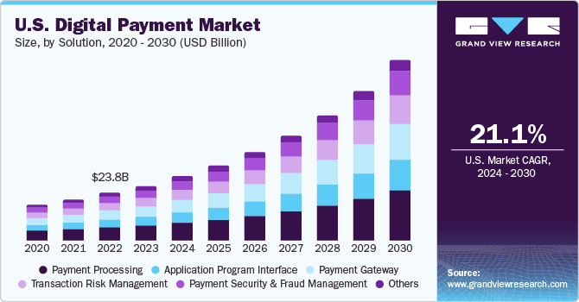
Macro/Policy/Market Outlook - Shay
Accelerating Digital Transformation in Payments
Global push toward cashless economies: The payments industry is undergoing rapid digitalization, driven by increased e-commerce penetration, growing mobile payment adoption, and a shift toward automated financial solutions.
Over 80% of global transactions are expected to be digital by 2030, with CPAY uniquely positioned to capture this growth through its global spend management platform.
Emerging markets are driving demand for cross-border payment solutions, offering CPAY opportunities to expand its global footprint.
CPAY’s Strategic Advantage in a Growing Sector
The global payments industry is expected to grow at a CAGR of 7–9% over the next five years, providing a substantial opportunity for Corpay to capture market share.
Regulatory Emphasis on Transparency
Regulatory initiatives promoting transparency in cross-border transactions benefit companies like Corpay that already adhere to high compliance standards.

Slide 22
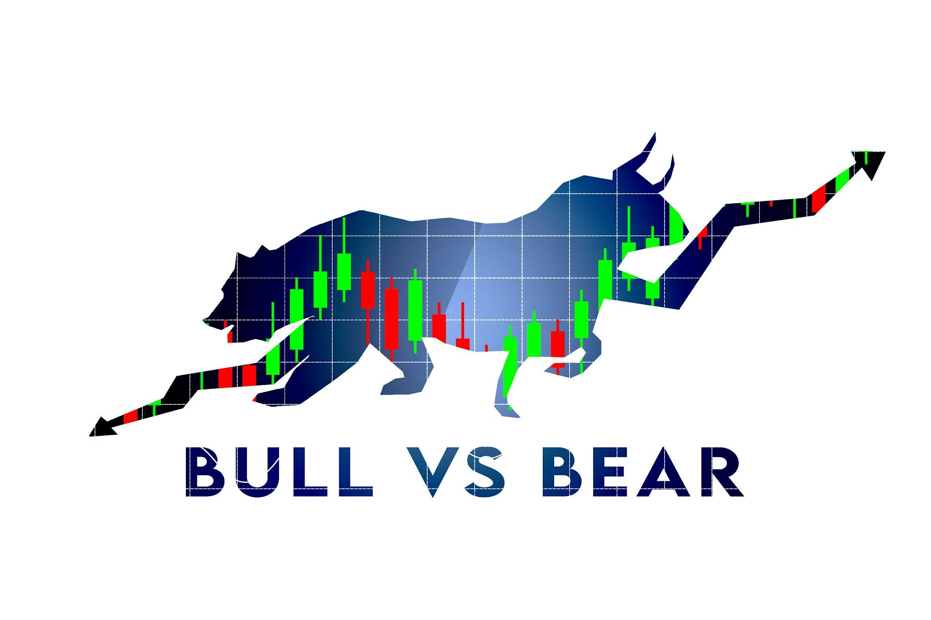
Risks
Regulatory and Compliance Risk
Corpay operates globally, which exposes it to varying laws and regulatory frameworks across different countries
Transactions within sanctioned countries could create unintentional fees and penalties
Non-compliance can lead to legal penalties and reputational damage
Market Competition
The corporate payments sector is crowded with competitors ranging from established financial institutions (e.g., major banks) to agile fintech startups
Economic downturns can reduce transaction volumes or discourage businesses from investing in additional payment solutions

Slide 23
Conclusion - David
Investment
Despite some regional integration issues and regulatory challenges, Corpay’s position as a leading B2B payments provider, differentiated from consumer-facing payment providers by its enterprise-focused solutions, diversified revenue model, global reach, and comprehensive product suite, makes it a valid buy for those seeking stability and long-term growth
Timeline
Long-term hold
Some volatility is expected

Slide 24
Discuss & Vote!

